Slide 1
Notes:
Graph 2. Missing Variables
Left Horizontal Bars:
Weight_12m_kg = 30 missing total
ALT = 30 missing total
Fiber_intake_g = 30 missing total
Shannon_diversity = 30 missing total
WHO_zBMI_12m = 30 missing total
Top Vertical Bars:
25 = Fiber intake only, 25 people are missing Fiber intake
24 = Shannon diversity only, 24 people are missing Shannon diversity
22 = ALT only, 22 people are missing ALT
21 = Weight 12m kg + WHO zBMI 12m, 21 people are missing both
4 = Weight_12m_kg + ALT + WHO zBMI 12m, 4 people are missing three
3 = Weight_12m_kg + Shannon diversity + WHO_zBMI_12m, 3 people are missing three
2 = ALT + Fiber intake, 2 people are missing both
2 = ALT + Shannon diversity, 2 people are missing both
2 = Weight 12m kg + Fiber intake + WHO zBMI 12m, 2 people are missing three
1 = Fiber intake + Shannon diversity, 1 person is missing both
"Are these 5 variables missing more in certain types of participants?"
If yes → missingness is not random → needs careful imputation strategy
If no → missingness is random → safer to impute or drop

Slide 3
Data Preprocessing
Unsupervised Clustering
Clusters Validation
Supervised Learning
Data Interpretation
R package 1
R package 2
R package 5
(All variables)
Check missingness
Data standardization
Clean data
(4 Variables)
NbClust voting for K
Elbow method
Silhouette Analysis
PCA Visualization
Multiple K Comparison
Index Heatmap
Stability validation
R package 3
Euclidean metric
Manhattan metric
(Hopkins)
R package 4
K means clustering
PAM clustering
Hierarchical clustering

Slide 4
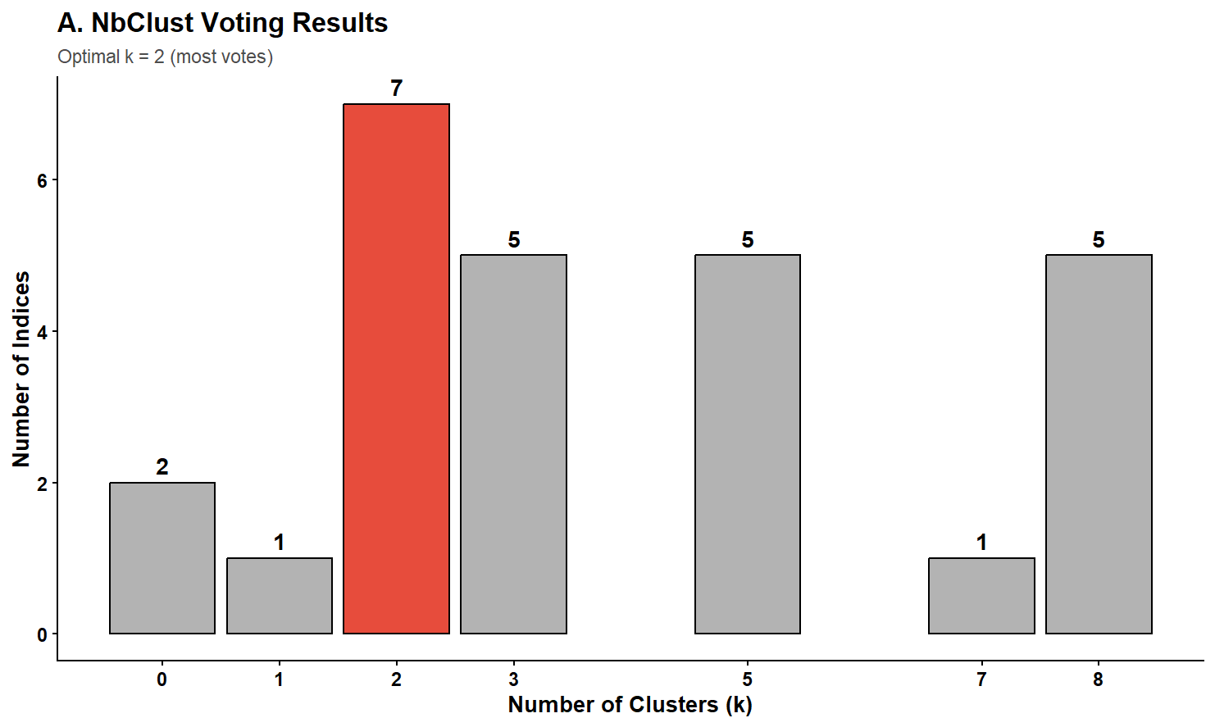
Section 2: Unsupervised Clustering
Plot 1. NBClust voting result

Slide 5
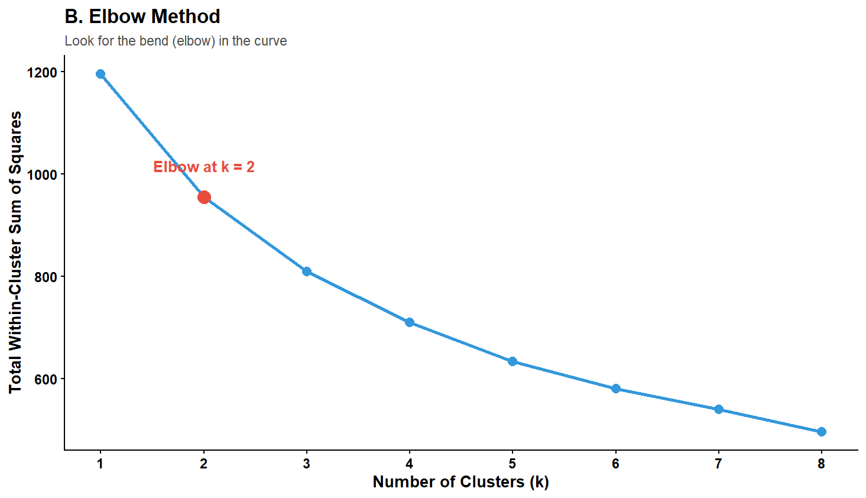
Section 2: Unsupervised Clustering
Plot 2. Elbow method result

Slide 6
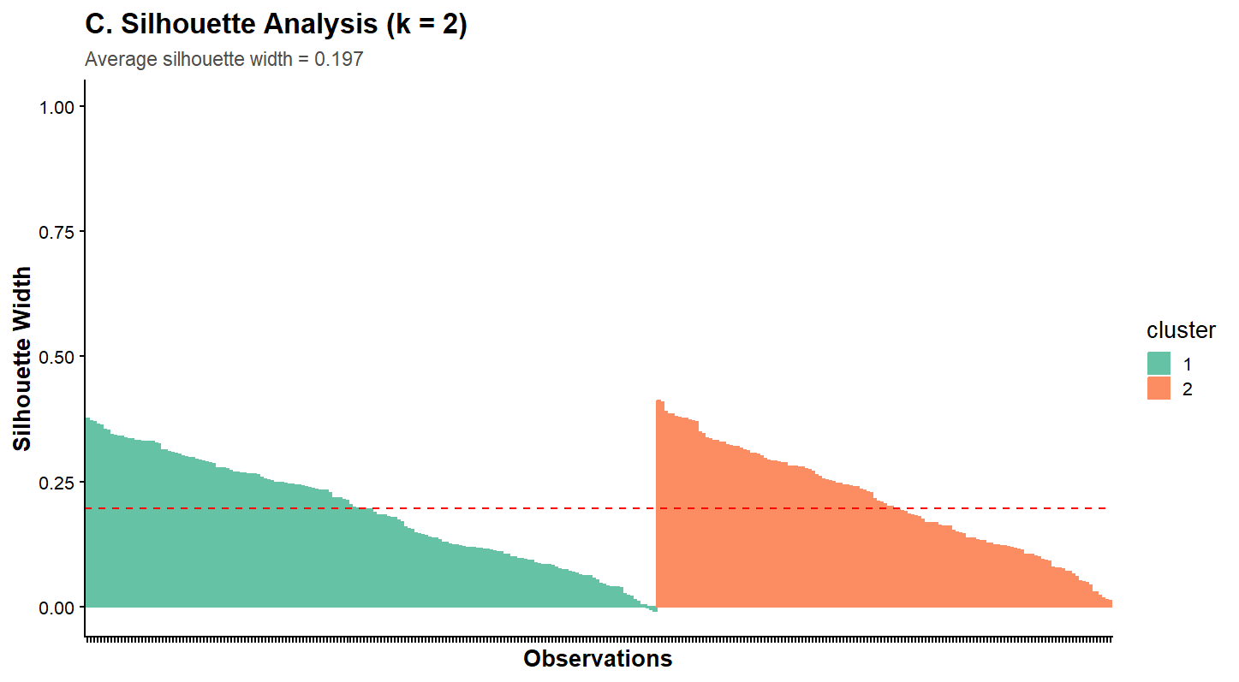
Section 2: Unsupervised Clustering
Plot 3. Silhouette analysis result

Slide 7
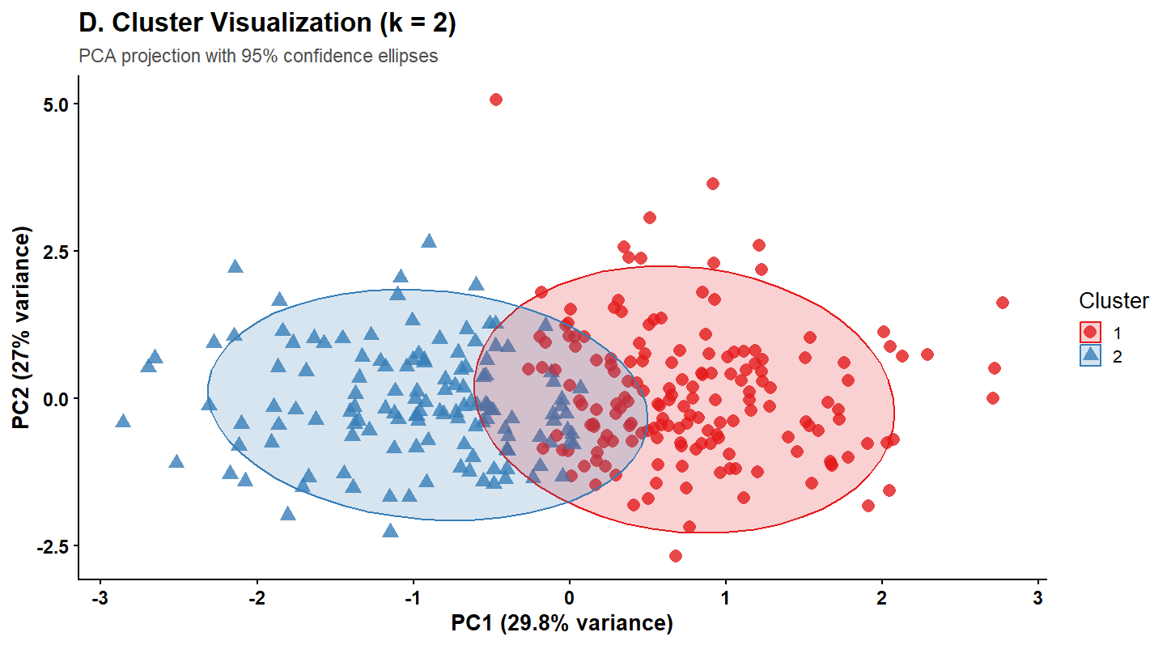
Section 2: Unsupervised Clustering
Plot 4. PCA cluster visualization of 2 clusters

Slide 8
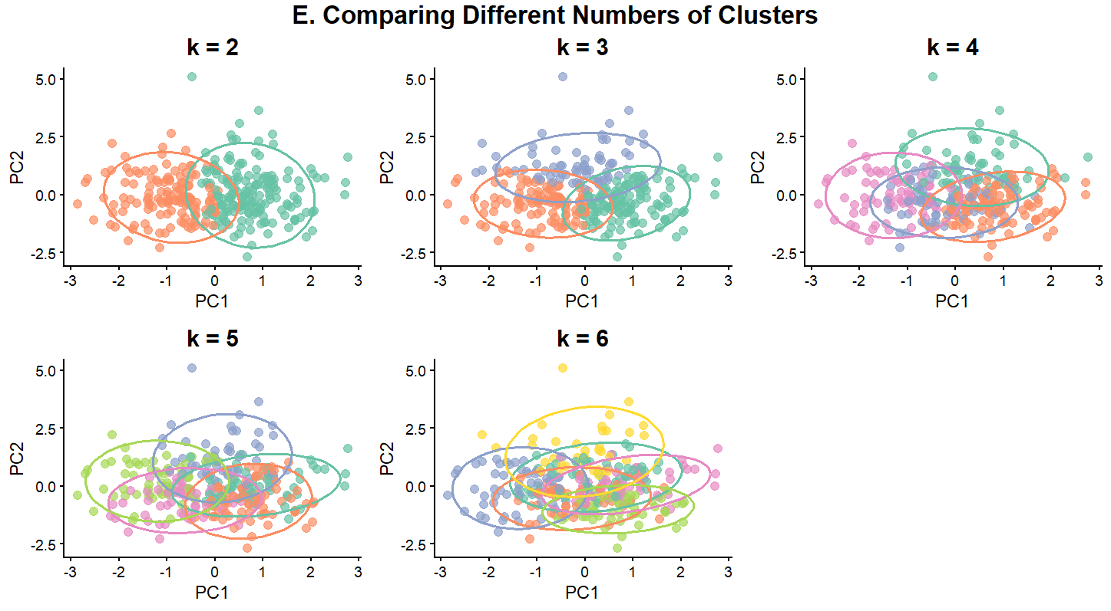
Section 2: Unsupervised Clustering
Plot 5. Comparisons of cluster numbers

Slide 9
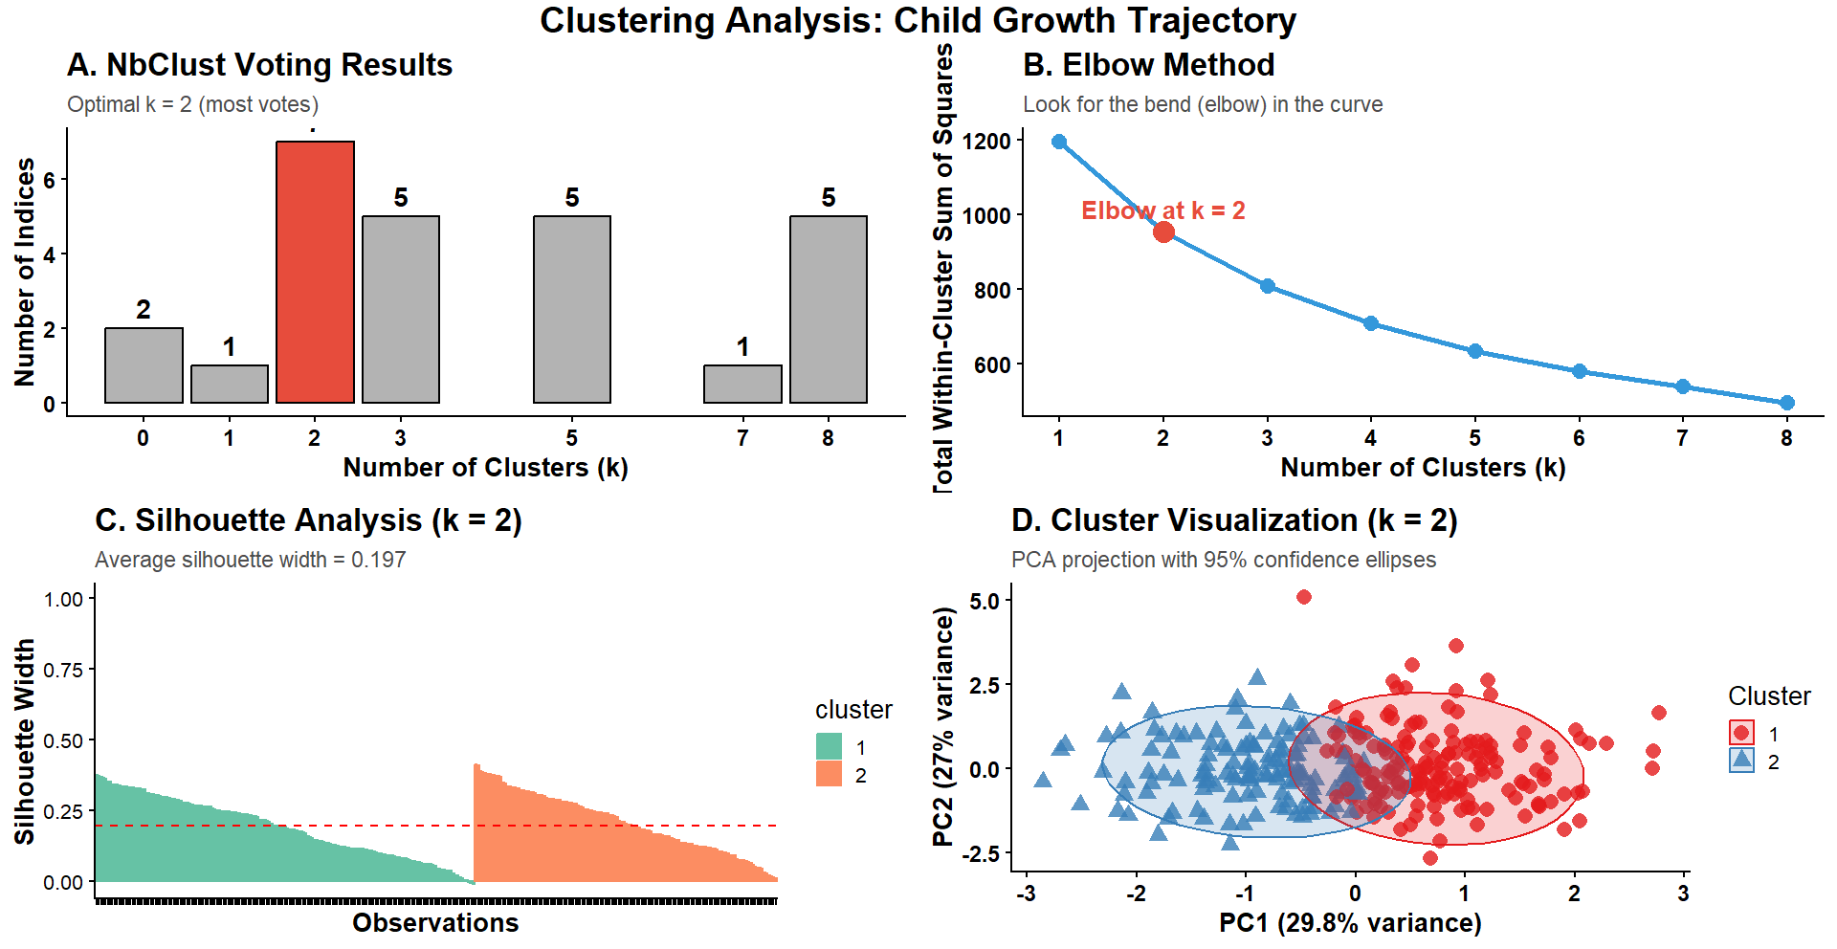
Section 2: Unsupervised Clustering
Plot 6. Summary plots of exploratory data analysis

Slide 10
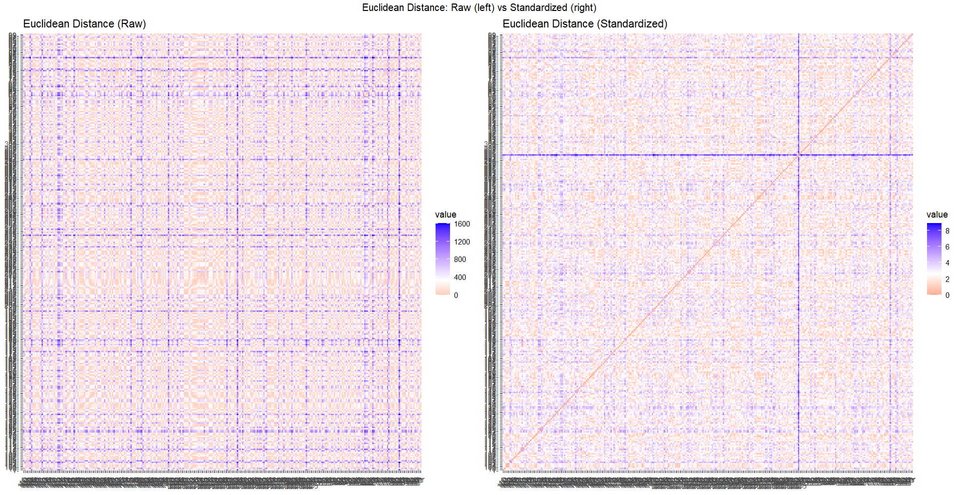
Section 2: Unsupervised Clustering
Plot 7. Euclidean distance data visualizations

Slide 11
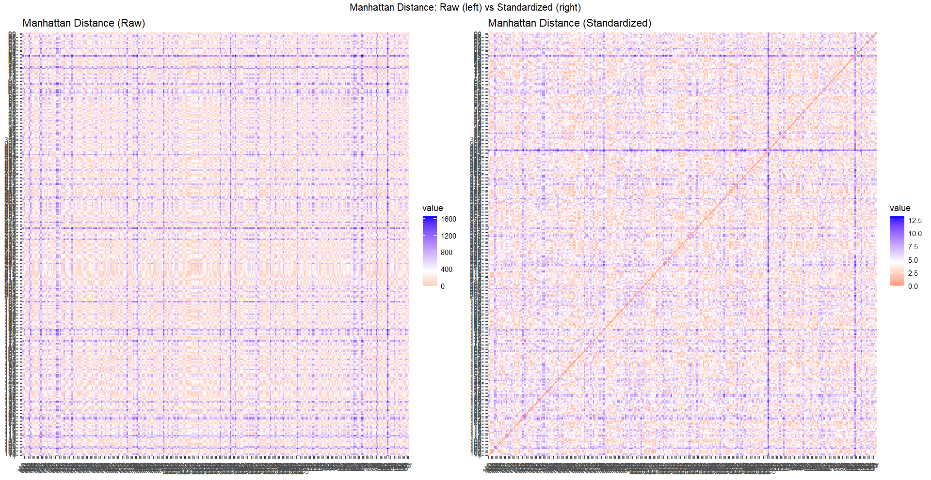
Section 2: Unsupervised Clustering
Plot 8. Manhattan distance data visualizations

Slide 12
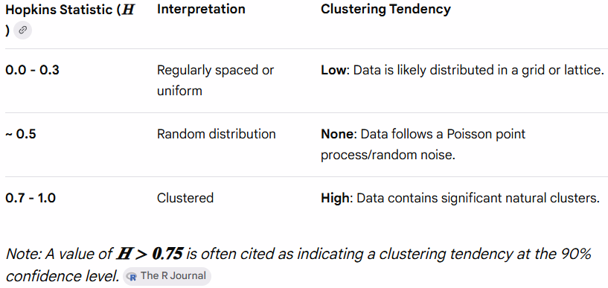
Section 2: Unsupervised Clustering
Hopkins Statistic Explanation
Hopkins Statistic Results
Hopkins statistic: 0.995
> cat("Interpretation:",
+ ifelse(hopkins_stat > 0.5,
+ "Data shows cluster tendency - worth clustering",
+ "Data may be random - clustering may not be meaningful"), "\n")
Interpretation: Data shows cluster tendency - worth clustering
Our 4 variables have a very strong natural clustering structure
(Data is grouped in distinct patterns rather randomly distributed)
Notes:
Will the Real Hopkins Statistic Please Stand Up? by Kevin Wright (https://journal.r-project.org/articles/RJ-2022-055/RJ-2022-055.pdf)

Slide 13
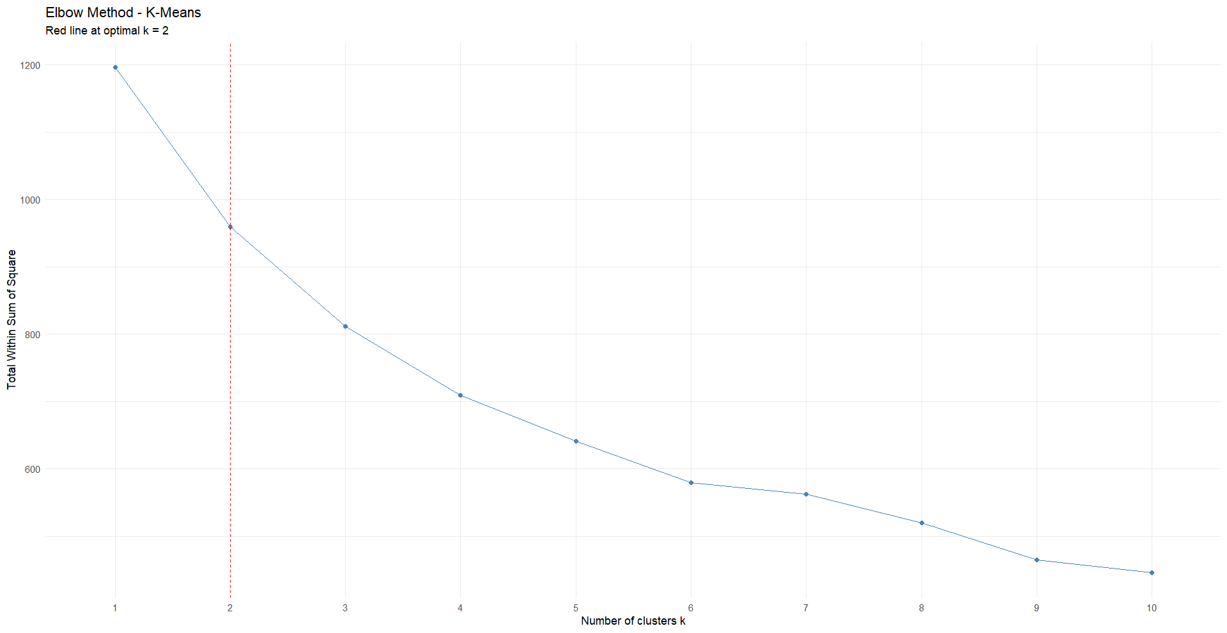
Section 2: Unsupervised Clustering
Plot 9. Elbow method K-means result

Slide 14
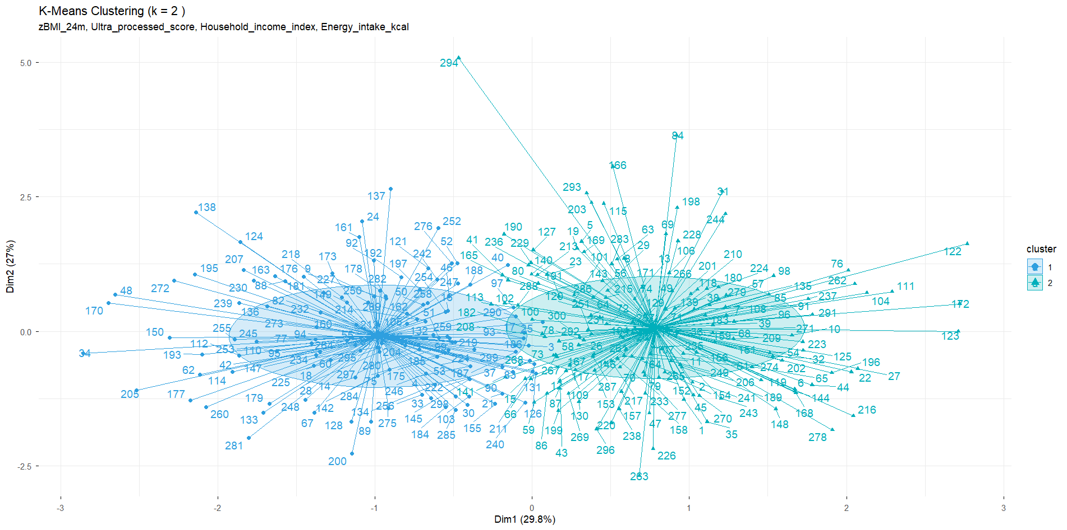
Section 2: Unsupervised Clustering
Plot 10. K-means clustering result

Slide 15
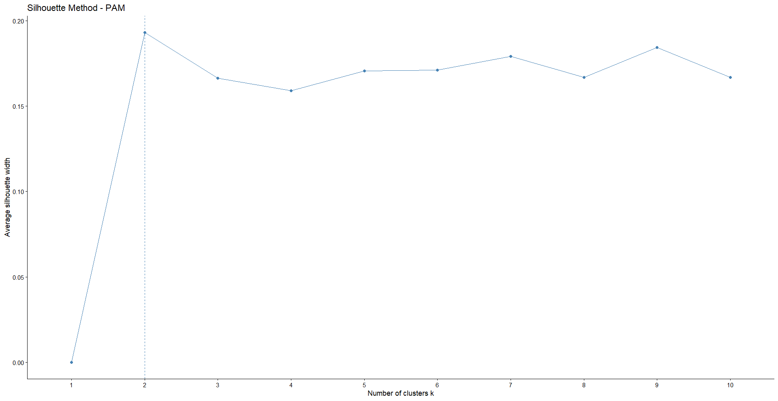
Section 2: Unsupervised Clustering
Plot 11. Silhouette method (PAM) result

Slide 16
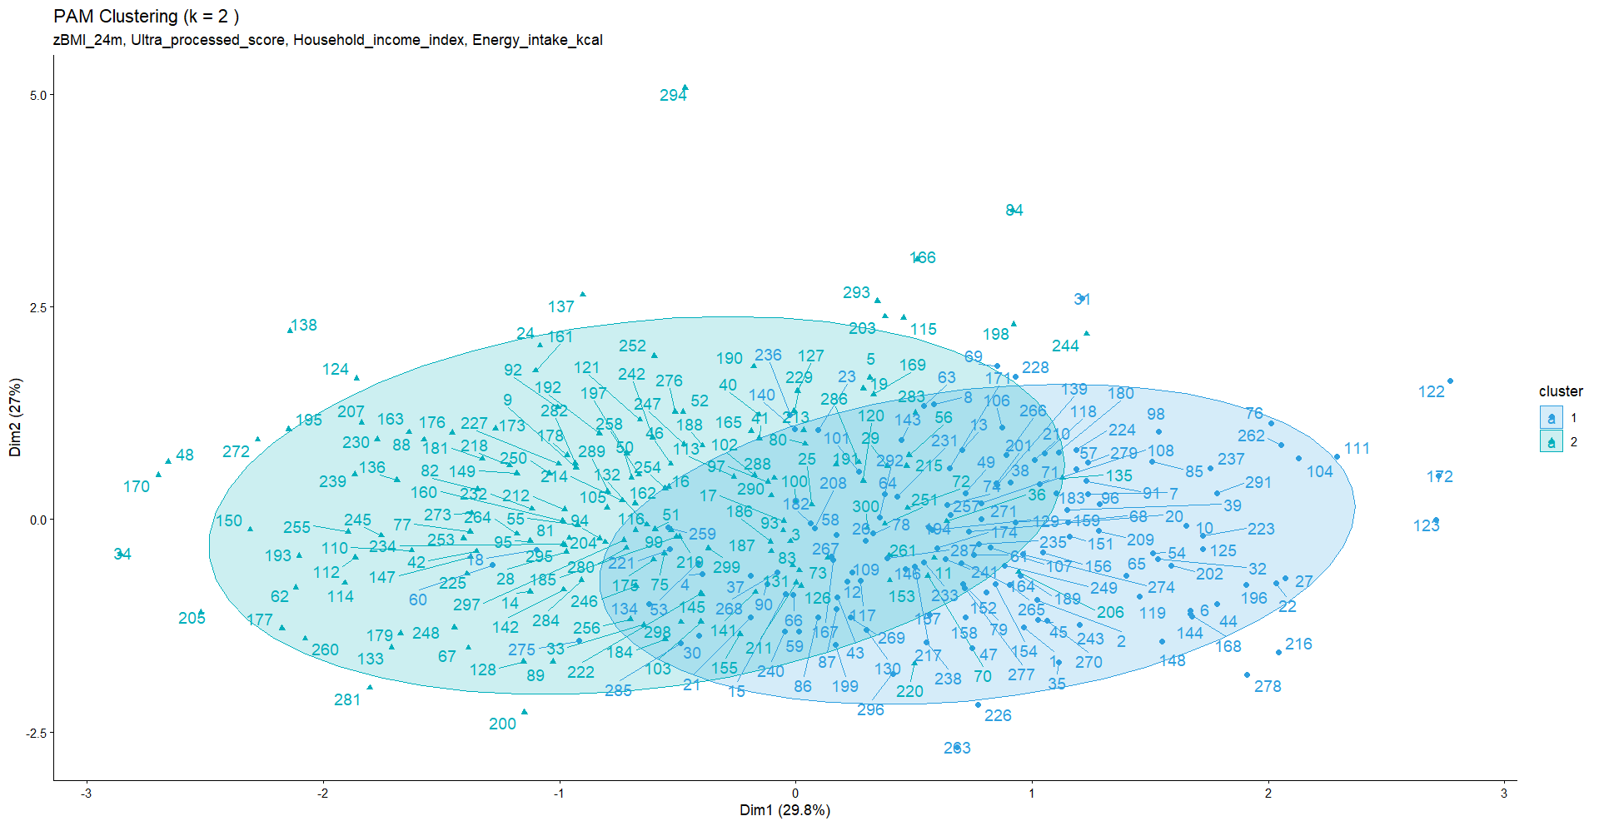
Section 2: Unsupervised Clustering
Plot 12. Silhouette method (PAM) clustering result

Slide 17
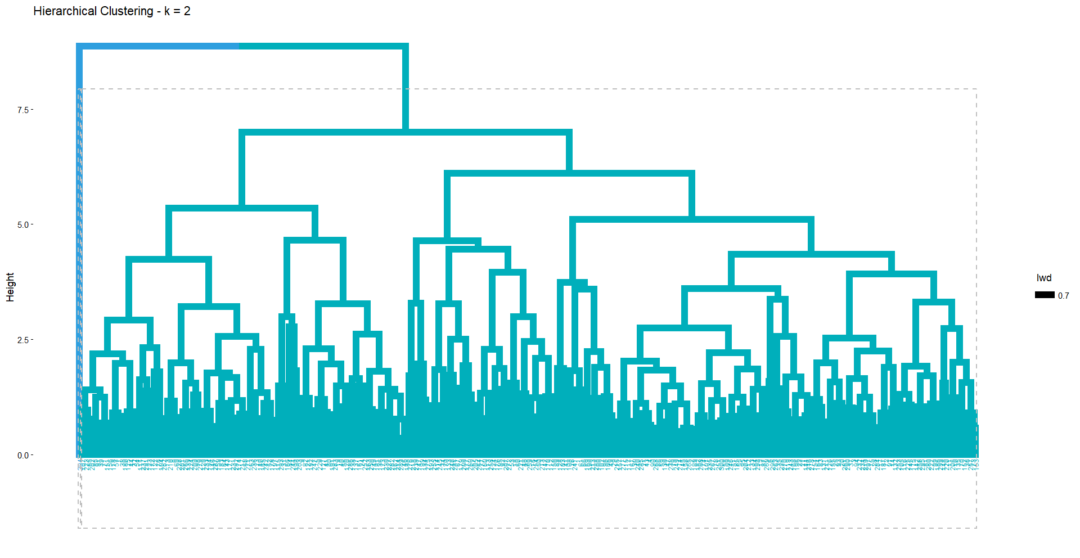
Section 2: Unsupervised Clustering
Plot 13. Hierarchical clustering result

Slide 18
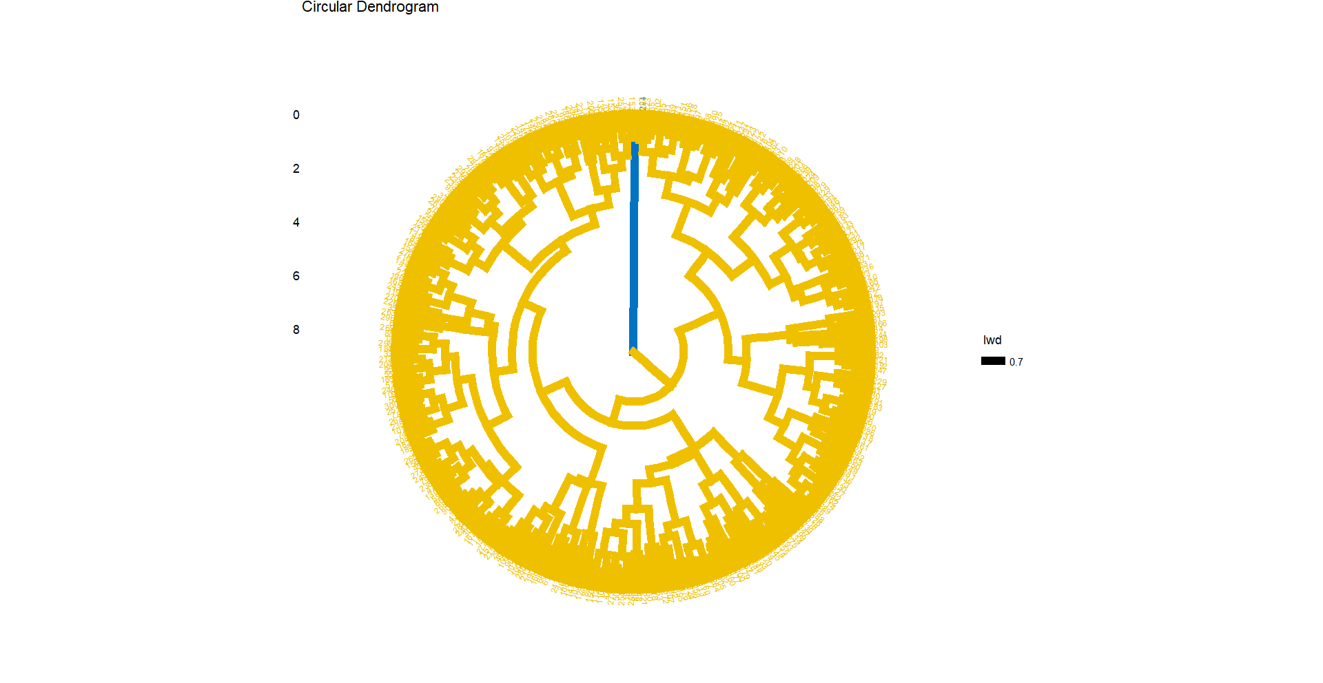
Section 2: Unsupervised Clustering
Plot 13. Hierarchical clustering (circular) result

Slide 19
Section 2: Unsupervised Clustering
Using 2 as the optimal K value:
K-Means
300 children → 2 clusters (133 & 167) = meaningful
PAM
300 children → 2 clusters (139 & 161) = meaningful
Hierarchical
300 children → 2 clusters (299 & 1) = failed
K-Means and PAM both agree on a 2-cluster solution

Slide 20
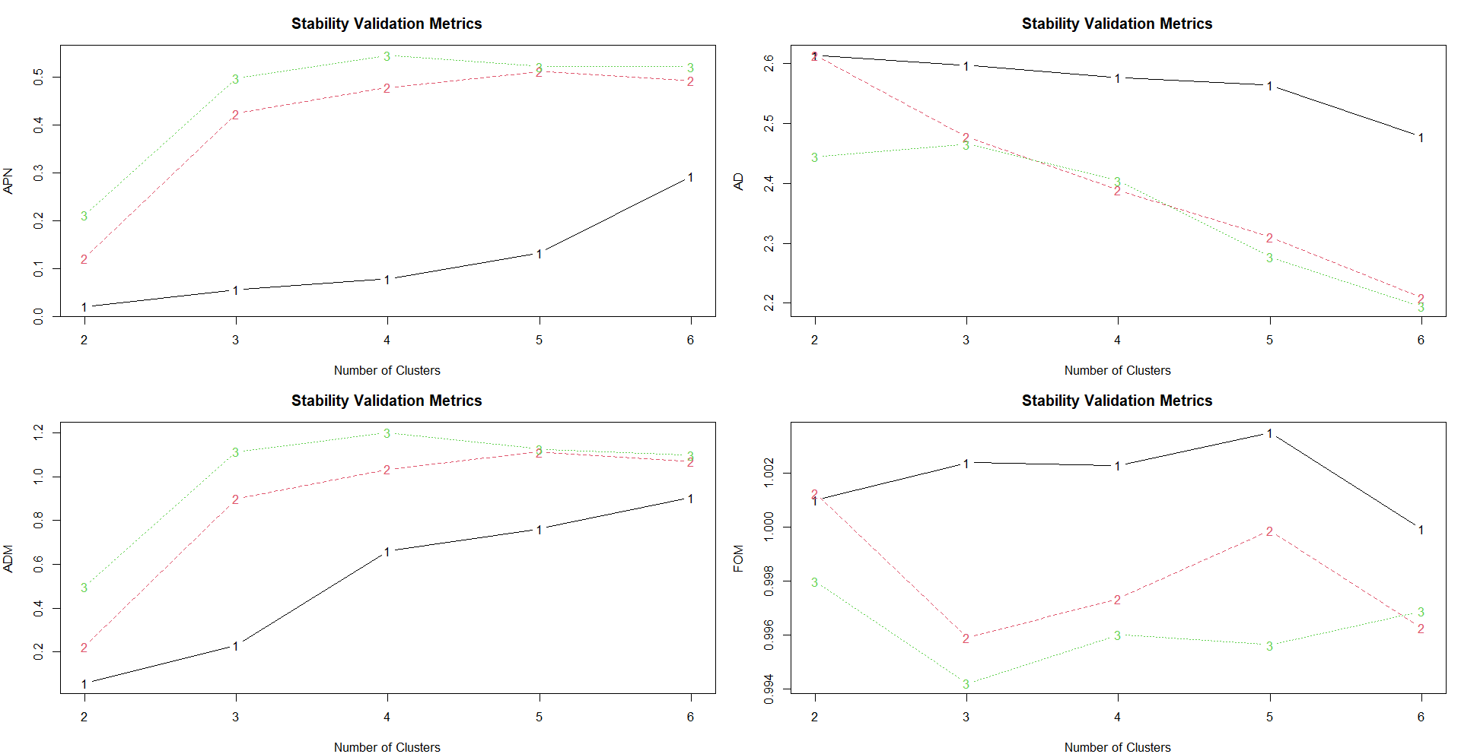
Section 3: Clusters Validation
Plot 14. Stability validation results (APN, AD, ADM, and FOM)
Hierarchical clustering (black)
K-Means clustering (red)
PAM clustering (green)

Slide 21
Section 3: Clusters Validation
Stability Tests Summary:
APN (Average Proportion of Non-overlap) | AD (Average Distance) | ADM (Average Distance between Means) | FOM (Figure of Merit)
“How consistently observations stay in the same cluster when one variable is removed” | “Measures average distance between observations in the same cluster across full vs. reduced data” | “How much cluster centers shift when one variable is removed” | “Measures intra-cluster variance of the removed variable”
Lower = more stable | Lower = more stable | Lower = more stable | Lower = more stable
Hierarchical wins | PAM wins | Hierarchical wins | PAM wins
Best k = 2 | Best k = 6 | Best k = 2 | Best k = 3

